Slide 1
COMPLAINT BOX FOR
SOCIAL WELFARE
Suman Ramesh Tulsiani Charitable Trust's
Suman Ramesh Tulsiani Technical Campus-Faculty of Engineering
Department of Computer Engineering
Sponsor Project ( Vice President of Pimpri-Chichwad - Sameer Jawalkar )
Presented By
Sanket Sabale
Vaibhav Balghare
Under Guidance of
Prof. Anjali M. Dalvi

Slide 2
Index ( Content )
Problem Statement
Goals
Tech Stack
Functionality
Architecture & Algorithms
Scope of Project
Conclusion

Slide 3
Problem Statement
Sameer Jawalkar wants to make an app for user so that the user can send there problem and can be resolved in small amount of time.
User Can see there Problem Status easily or they can directly contact to Sameer Jawalker.
No middle man is Required for handling users complaint.
Voter Can see his details in these app with fully offline functionality.
Multiple Platforms can run these app.

Slide 4

Goals ( Objectives )
User Can fill Complaint Details with minimum information.
Location will be picked automatically.
User Can see his Voter Details by searching his name.
Voter Details fetching is fully offline.
Admin app for sharing work details.
Admin can handle more functionality in Users app.

Slide 5
Tech Stack ( Specification )
Software - Visual Studio Code , Nodejs , Extensions.
Operating System - Mac / Windows.
Framework - React Native, NextJs .
Programming Language - JavaScript.
Other - Play Store Console.

Slide 6
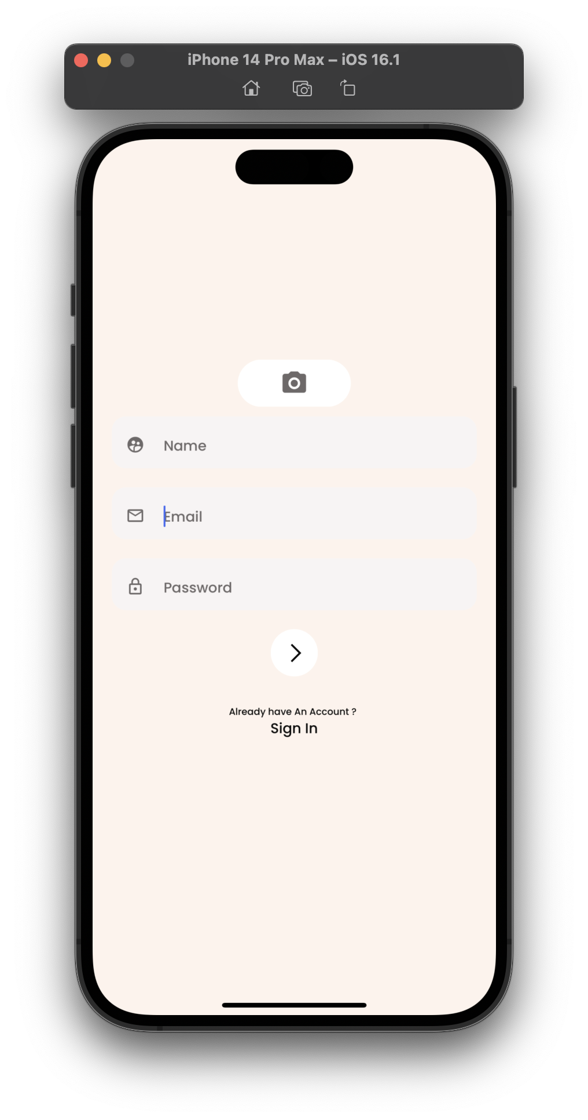
Functionality
1. Authentication
Registration and Login.
In Registration Verification Can be done through out the Mobile OTP Verification.
Registration is with CAPTCHA for more Security.
Login need Mobile no. And Password

Slide 7
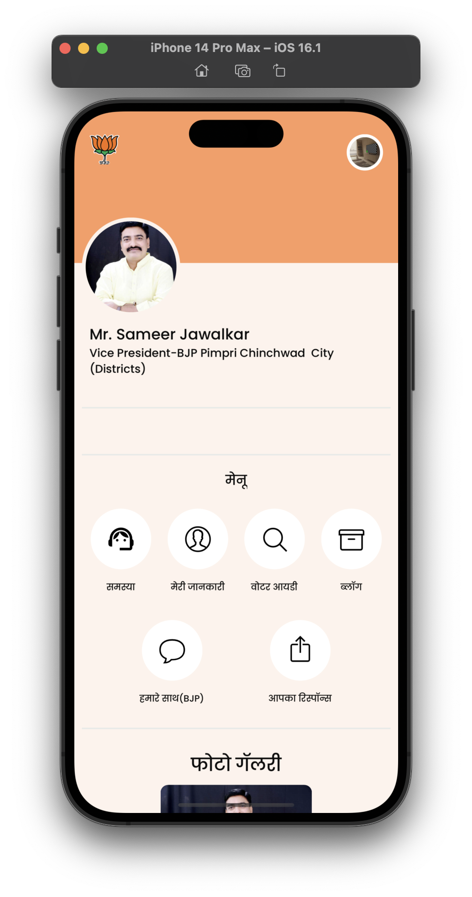
2. Home Interface
Profile Icon
Menu
Complaint
About me
Voter Id …..
Photo Gallery
Social Media Link

Slide 8
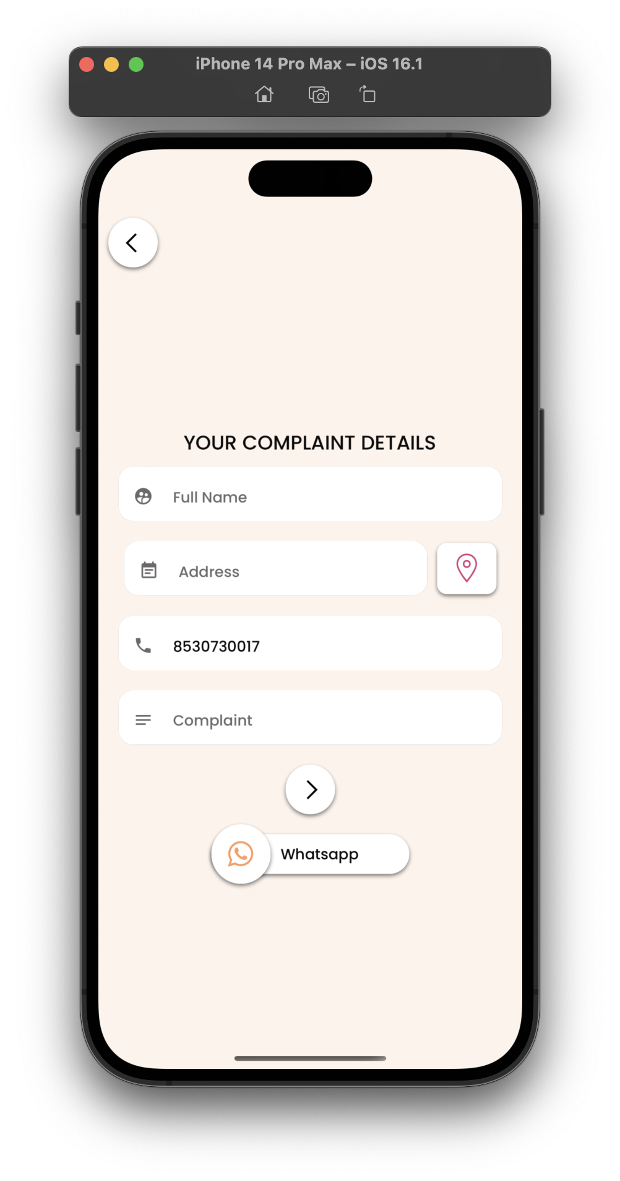
3. Complaint Filling
User need to put his name.
Location can be picked up automatically once click on location red button.
Mobile no cannot be edited because its verified one.
User Can Click submit button if all fields are filled up.
Whatsapp Button for those if in case the issue is very important.

Slide 9
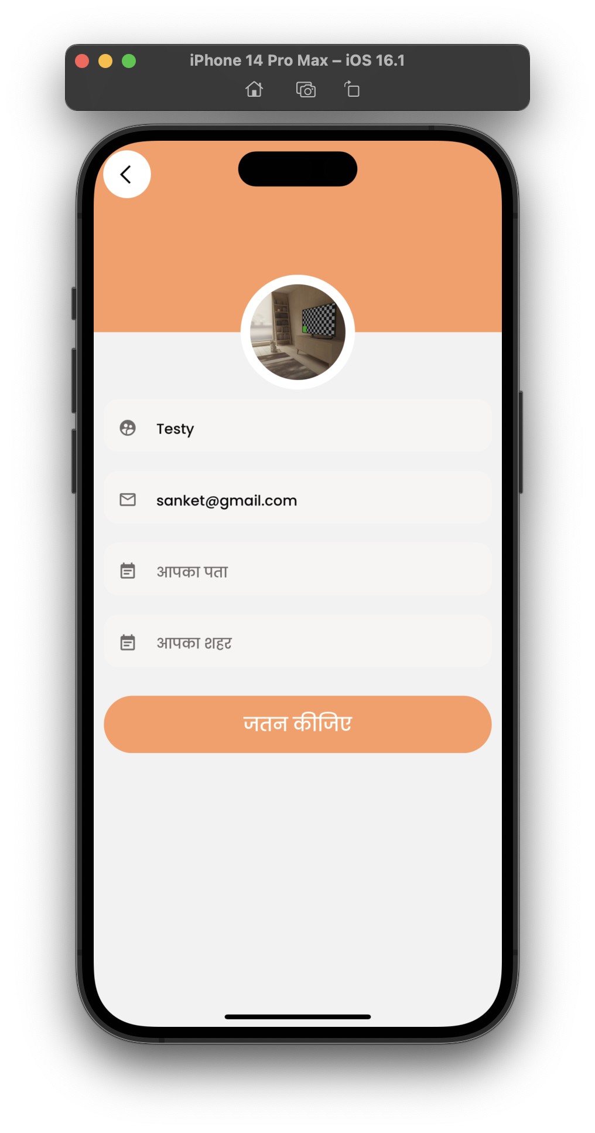
4. User Profile Editing
At Registration user need to fill some required details.
Here User can manage his all details accept his mobile no.
Logo,Name,Email can be changed.
Address and City User can add but those are not required one.

Slide 10
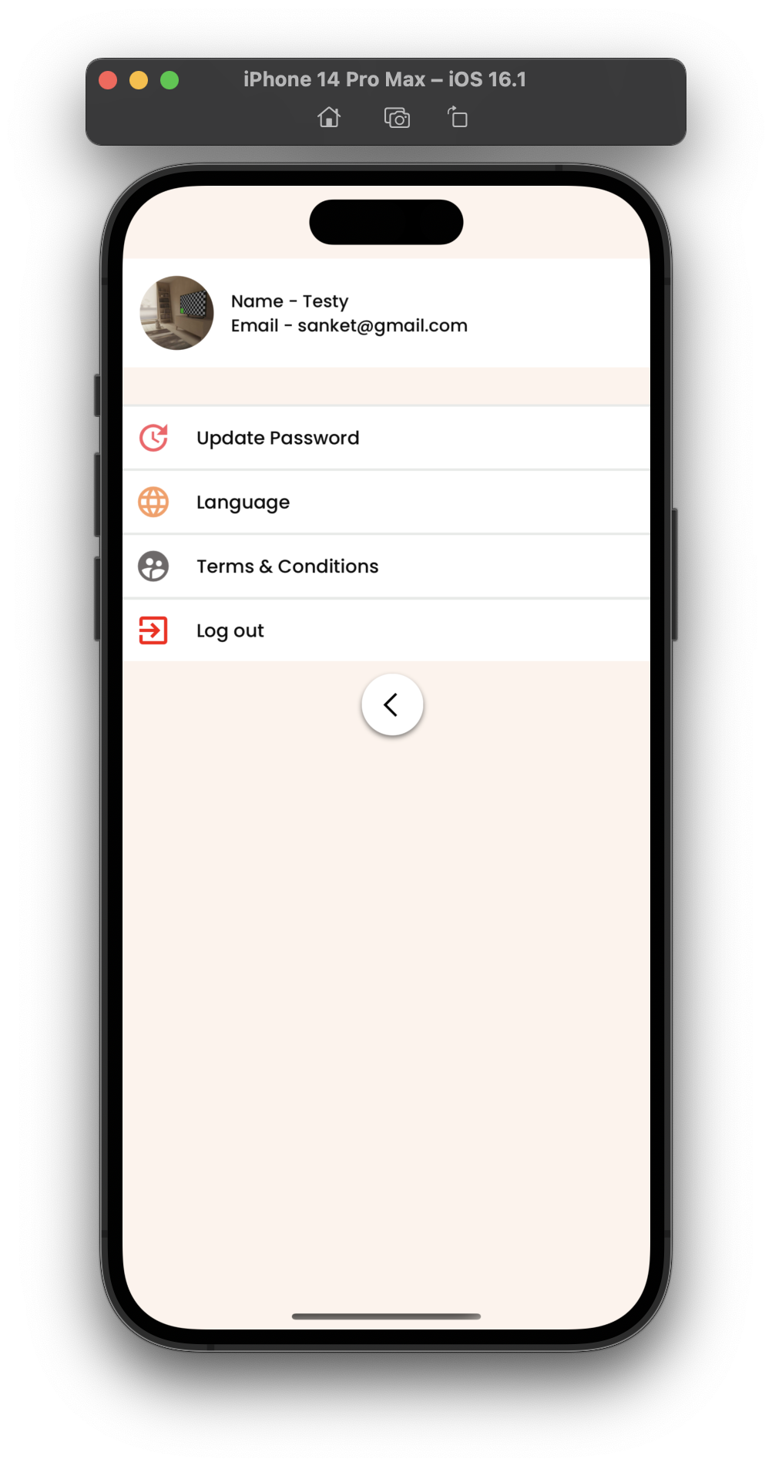
5. Settings Page
Update Password.
Change Language.
Term and Condition.
Log out.

Slide 11
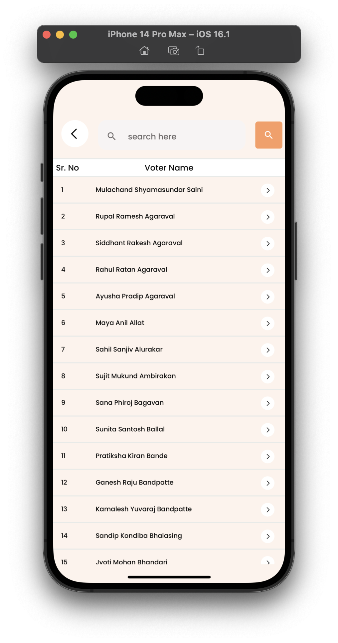
6. Voter Details
These Page Container 34k+ Voter data.
Search name with any formate.
Result can be see in less that 3 sec.

Slide 12
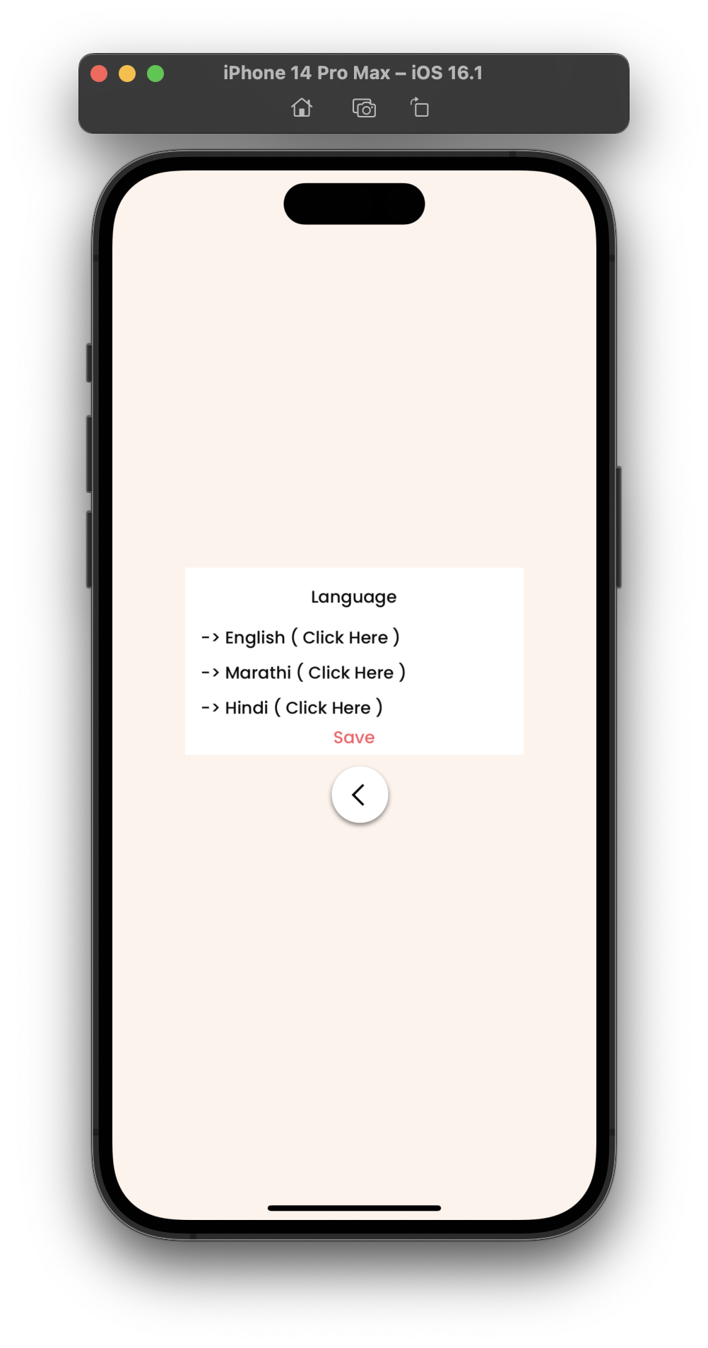
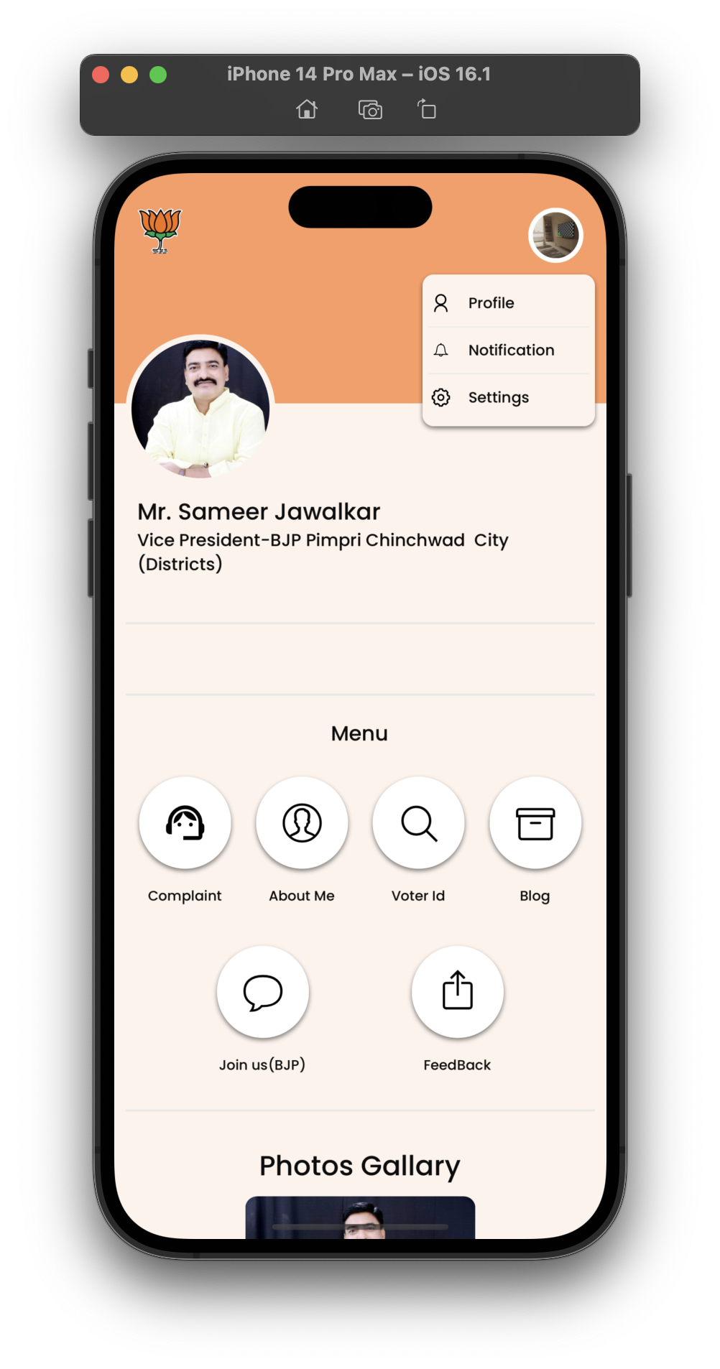
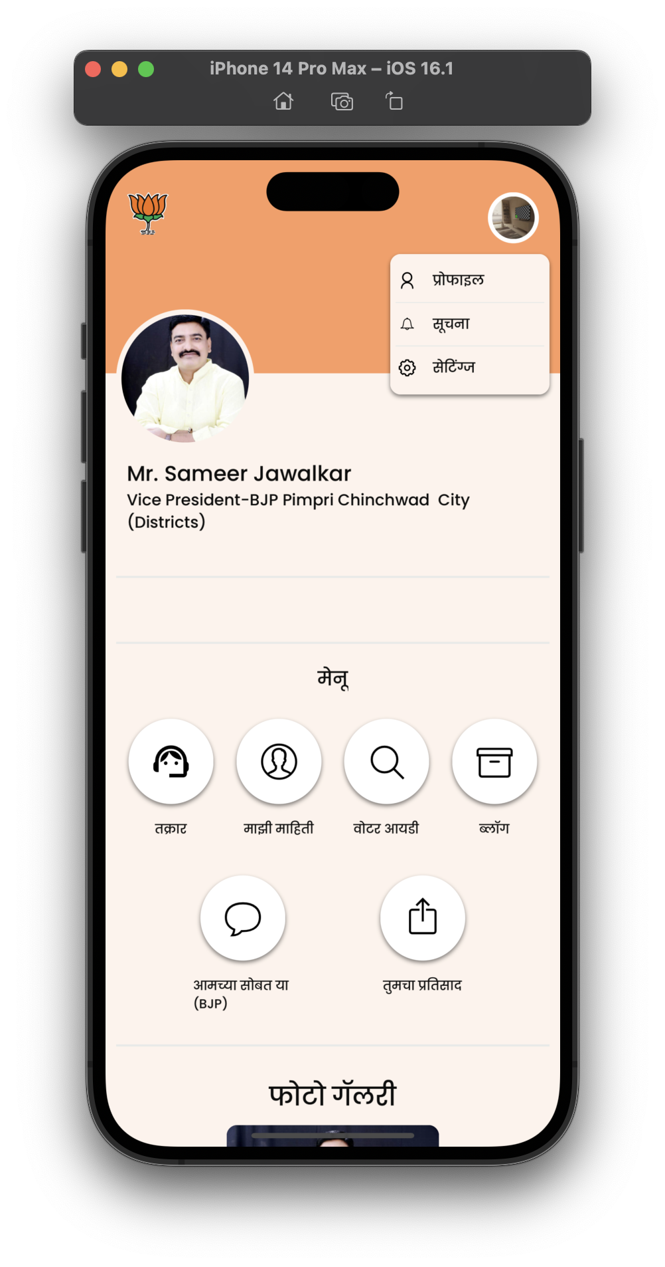

7. Multi-Language Support

Slide 13
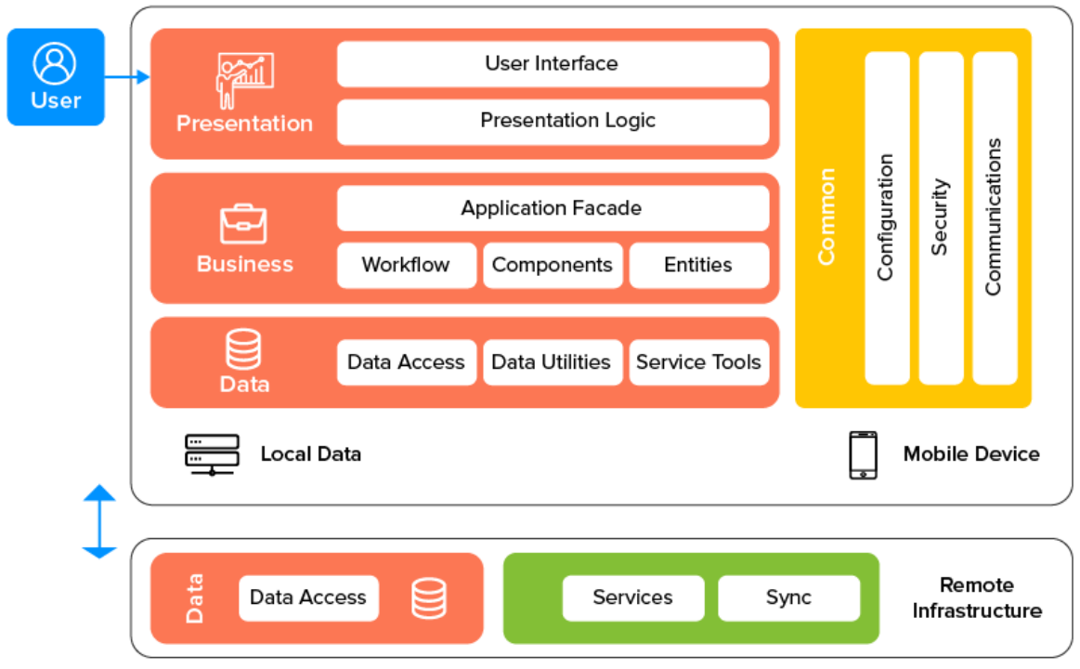
Architecture

Slide 14
Used Algorithms
Brute Force - Fetching all Voters in single page.
Greedy Algorithm - Picking up right result form voters using less complexity.

Slide 15
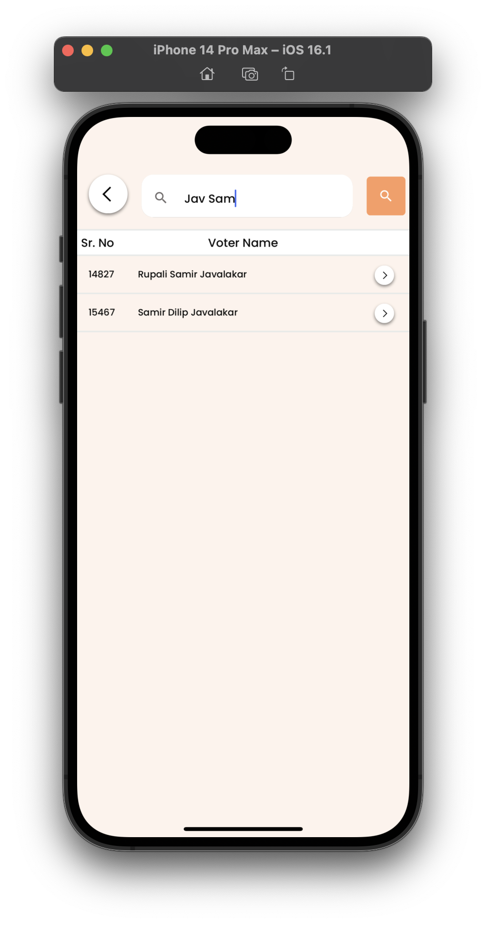
Custom Algorithm
- For Searching Voter in Any format name
Search name in Any formate.
More Scalable at O(n) Complexity.
34k+ data render at smaller amount of time.
No Extra Storage Required.

Slide 16

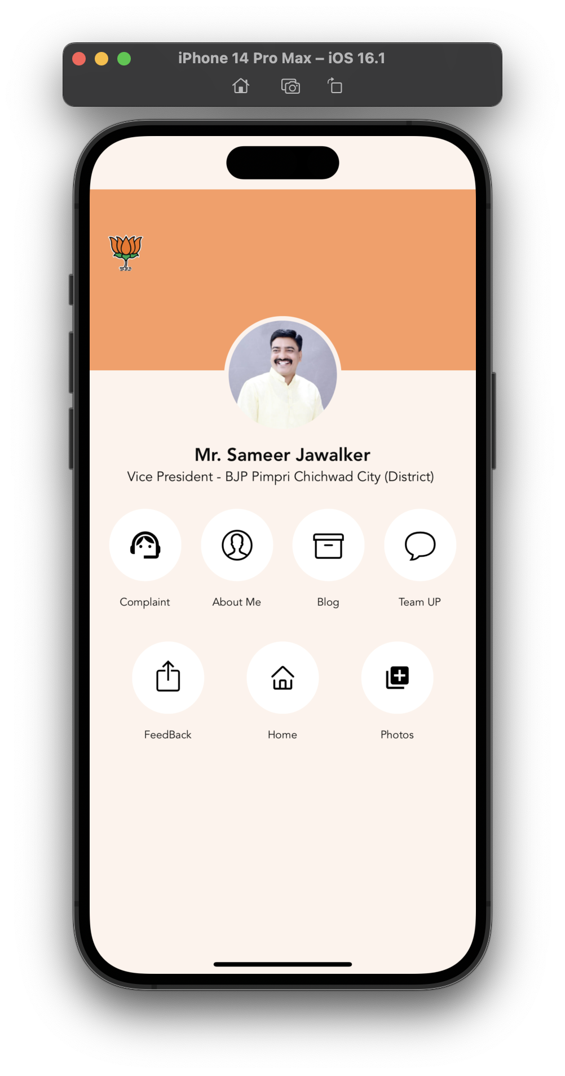
Admin Application Functionality
Handle Complaints.
Create, Update, Delete Blogs.
Managing Home Screen Details.
Add More Photos.
See Feedback.

Slide 17
Literature Review
SR.NO | Title of Paper/Year/Authors | Methodology | Findings and Application | Future Scope
1 | Authentication Model using the Bundled CAPTCHA OTP Instead of Traditional Password | Secure Mobile Authentication | getting ready for captcha in valid mobile authentication system in application for validation of human | We can able to create more upgradable authentication system
2 | A Customer Complaint Analysis Tool for Mobile Network Operators | Understanding complaints from users | understading how we can able to handle same sort of complaints more many users. | Complaint that we take it need to be resolved so analysis make more sense
3 | Analysis of Cross-Platform Mobile App Development Tools | Cross app development | Developing app on both android and ios with single codebase | Making app for different os device make more complexity but cross platform can solve these problem.

Slide 18
Mathematical Model
For selected problem statement
S1 = { s, e, Y, F, Z }
s = Initial state :Registration and Login app.
e = End State : successful authentication of log out.
Y = For user : Request for Complaint.
For Admin : display data of user on mobile app
F = Algorithm Function used For fetching exact voter ID.
Z = result for voter.

Slide 19
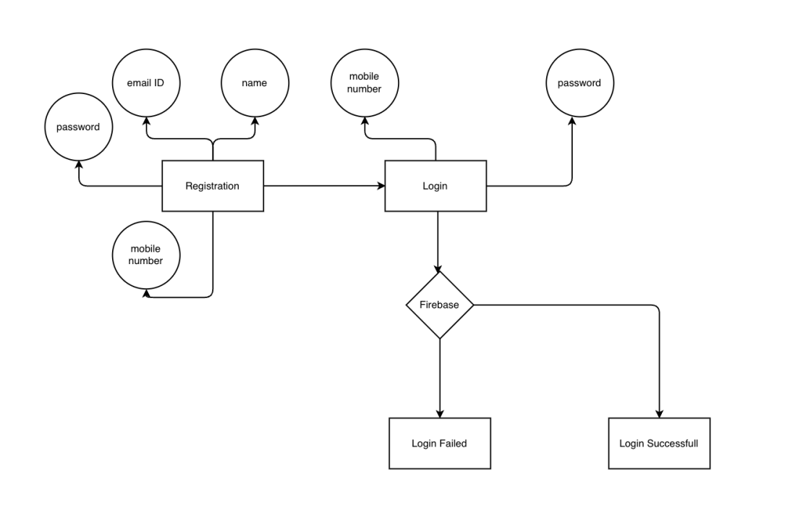
UML Diagrams

Slide 20
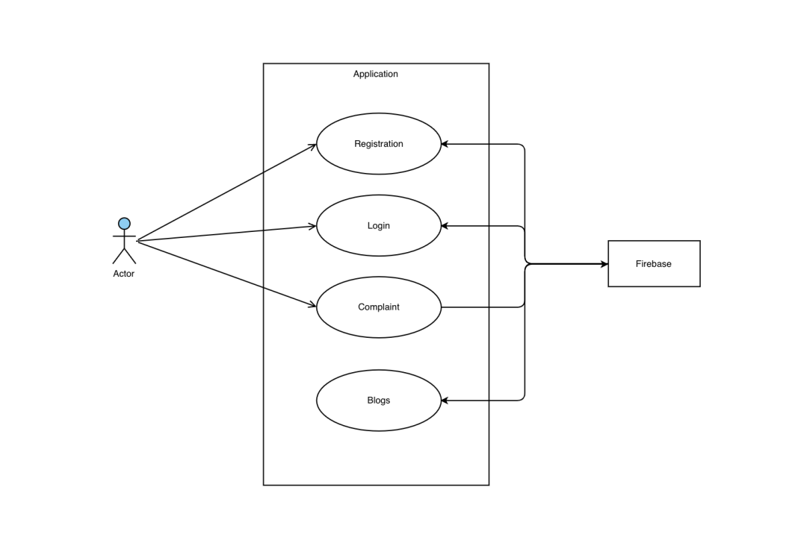

Slide 21
Future Upgrades
Make a status based things for complaint.
More Language Support.
Releasing app for App Store.
Latest Android or IOS Device can run it easily.

Slide 22
Conclusion
The Purposed Project is About to Create a better app for user for finding voter details and complaint solving, these app is more over helpful for Society where Sameer jawalkar stay so that the people can solve there problem via this app by contacting directly to them so admin app also help to Sameer jawalkar for understanding users complaints.

Slide 23
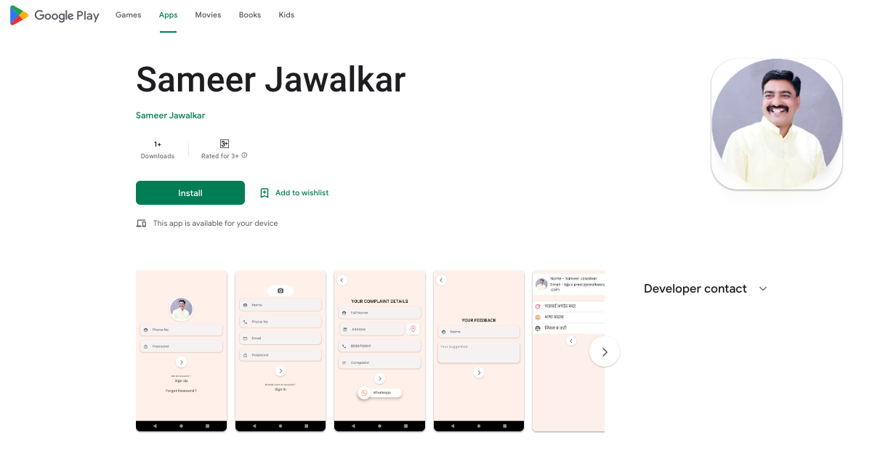
🤗
Thank You
Play Store Link - https://play.google.com/store/apps/details?id=in.sameerjawalkers.sameerjawalker

